Slide 1
Mathematical Economics

Slide 2
Linear Demand & Supply Functions

Slide 3
Typical Demand Function
Demand for a good can be expressed using mathematical functions
A typical demand function looks like Q_{D} = a – bP where,
Q_{D} represents the quantity demanded
a represents the autonomous level of demand, or the quantity demanded if the price were zero (Q-intercept)
b represents the change in quantity demanded resulting from a change in price (the slope calculated as ∆Q_{d}/∆P)
P represents the price of a single item

Slide 4
Example; Demand for Cappuccinos
Suppose the demand for cappuccinos in Richmond Hill can be expressed as Q_{D} = 600 – 50P
It is possible to construct both a demand schedule and demand curve from this demand function
Linear demand schedule: Cappuccinos
Price of Cappuccinos (P) | Quantity demanded per day (Q_{D})
10 | 100
8 | 200
6 | 300
4 | 400
2 | 500
0 | 600

Slide 5
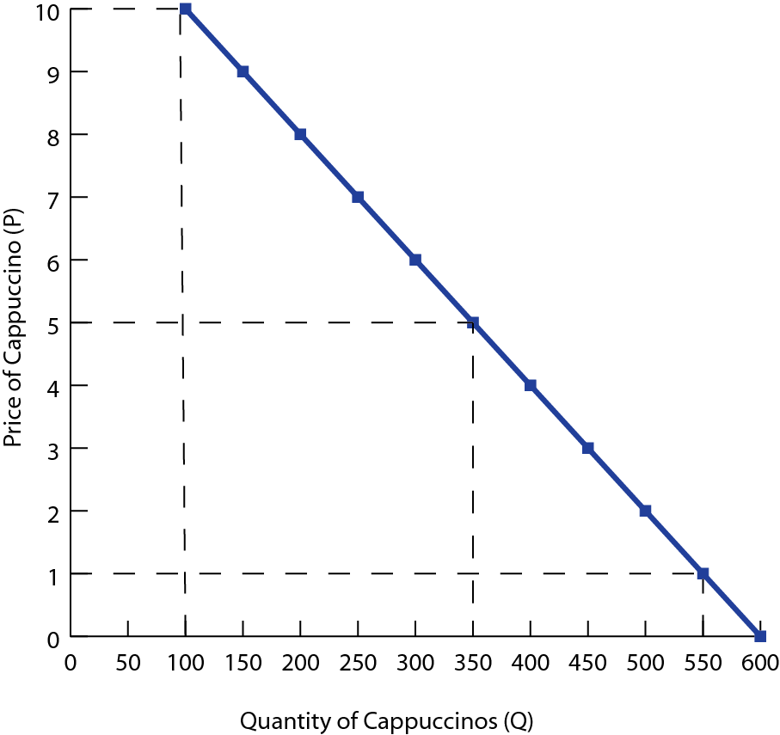
A movement along the demand curve will occur any time the price of cappuccinos increases or decreases
At lower prices, more are demanded; at higher prices fewer cappuccinos are demanded by consumers

Slide 6
Changes in ‘a’
If any of the determinants of demand change, then the ‘a’ value in the demand function will change
The demand curve will shift either left or right
Example; Suppose the demand function changes to Q_{D} = 500 – 50P
Linear demand schedule: Cappuccinos
Price of Cappuccinos (P) | Quantity demanded per day (Q_{D})
10 | 0
8 | 100
6 | 200
4 | 300
2 | 400
0 | 500

Slide 7
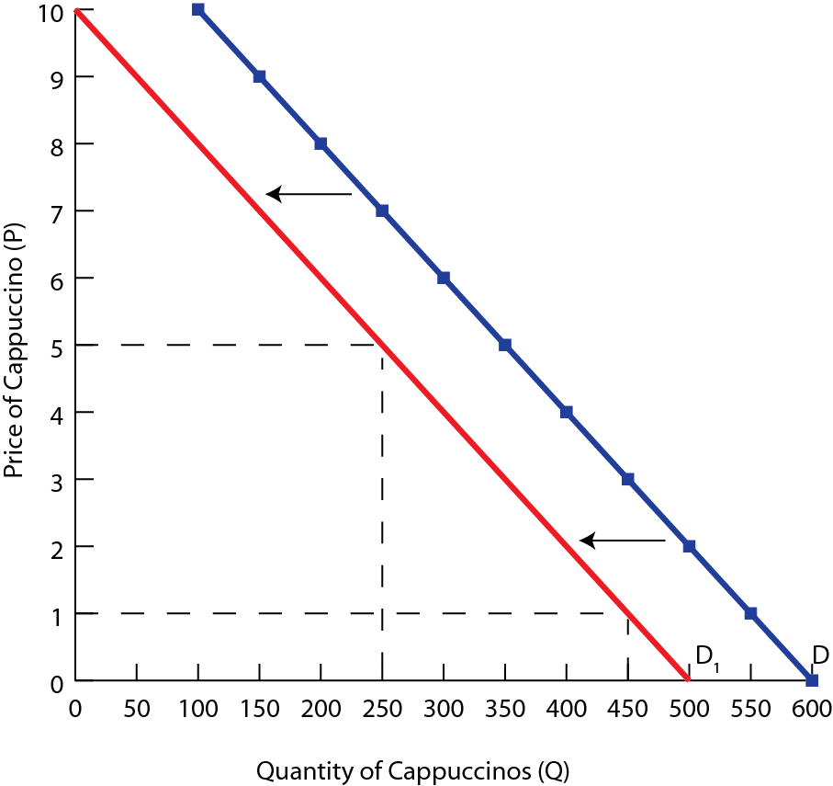
The slope of the new demand curve will be the same as the original curve
The demand curve shifts left, or down by 100 units at every price
The Q-intercept is now at 500 rather than 600

Slide 8
Changes in ‘b’
Changes to the price coefficient b will change the steepness of the demand curve
This changes the price elasticity of the demand curve
Example; Suppose the demand function changes to Q_{D} = 600 – 30P
Linear demand schedule: Cappuccinos
Price of Cappuccinos (P) | Quantity demanded per day (Q_{D})
10 | 300
8 | 360
6 | 420
4 | 480
2 | 570
0 | 600

Slide 9
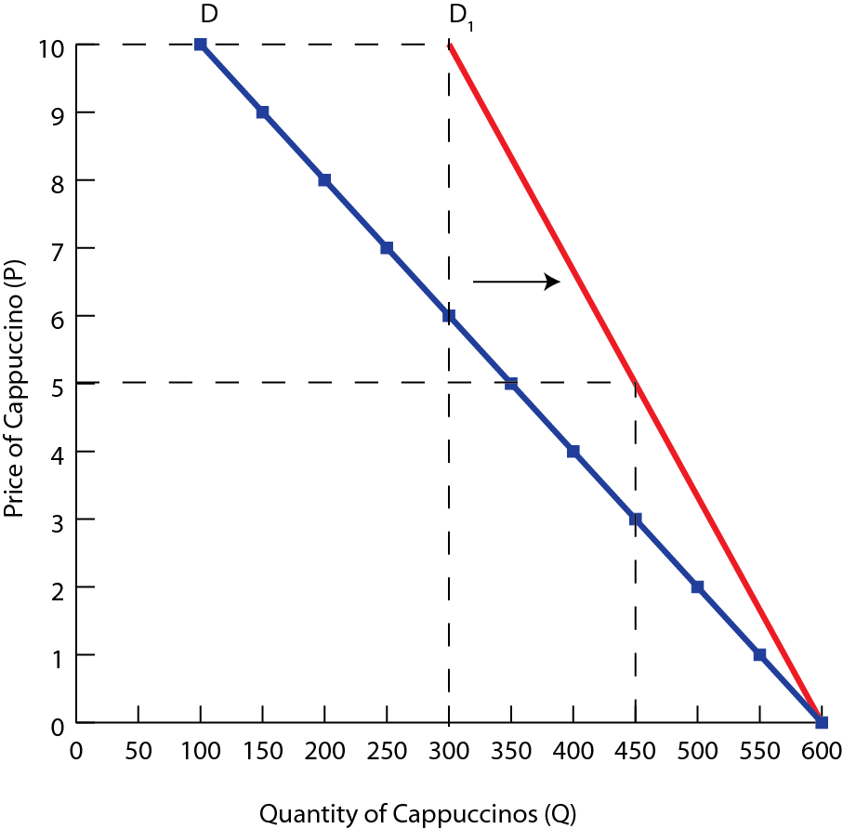
The demand curve has become steeper, indicating consumers are less sensitive to price changes than previously
The overall demand for cappuccinos has become more inelastic

Slide 10
Typical Supply Function
Supply for a good can also be expressed using mathematical functions
A typical supply function looks like Q_{S} = c + dP where,
Q_{S} represents the quantity supplied
c represents the autonomous level of supply, or the quantity produced if the price were zero (Q-intercept)
d represents the rate at which a change in price will cause the quantity supplied to increase (the slope calculated as ∆Q_{s}/∆P)
P represents the price of a single item

Slide 11
Example; Supply Cappuccinos
Suppose the supply of cappuccinos in Richmond Hill can be expressed as Q_{s} = -200 + 150P
It is possible to construct both a supply schedule and supply curve from this supply function
Linear supply schedule: Cappuccinos
Price of Cappuccinos (P) | Quantity supplied per day (Q_{D})
10 | 1300
8 | 1000
6 | 700
4 | 400
2 | 100
0 | -200

Slide 12
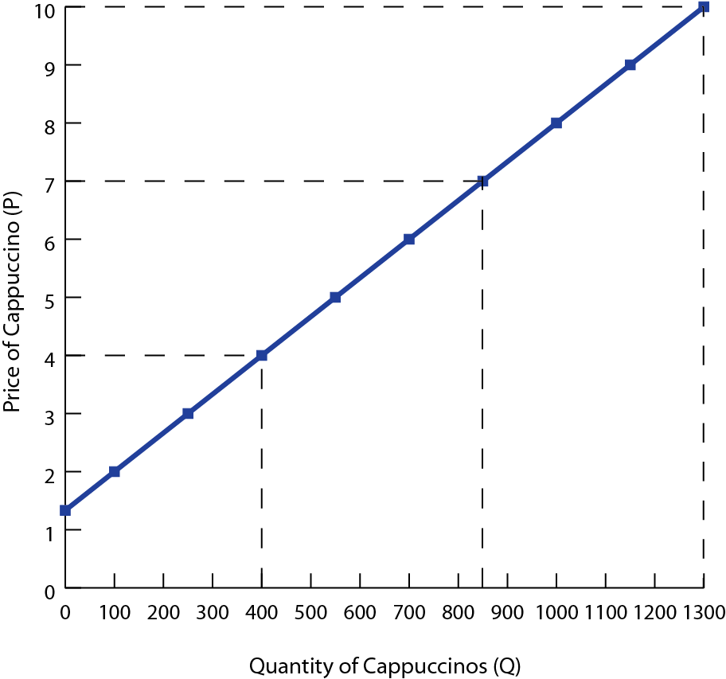
There is a direct relationship between the price and quantity supplied. As price falls, producers are willing to provide fewer drinks to the market

Slide 13
Changes in ‘c’
If any of the non-price determinants of supply change, then the ‘c’ value in the supply function will change
The supply curve will shift either left or right
Example; Suppose the supply function changes to Q_{S} = - 100 + 150P
Linear supply schedule: Cappuccinos
Price of Cappuccinos (P) | Quantity supplied per day (Q_{D})
10 | 1400
8 | 1100
6 | 800
4 | 500
2 | 200
0 | -100

Slide 14
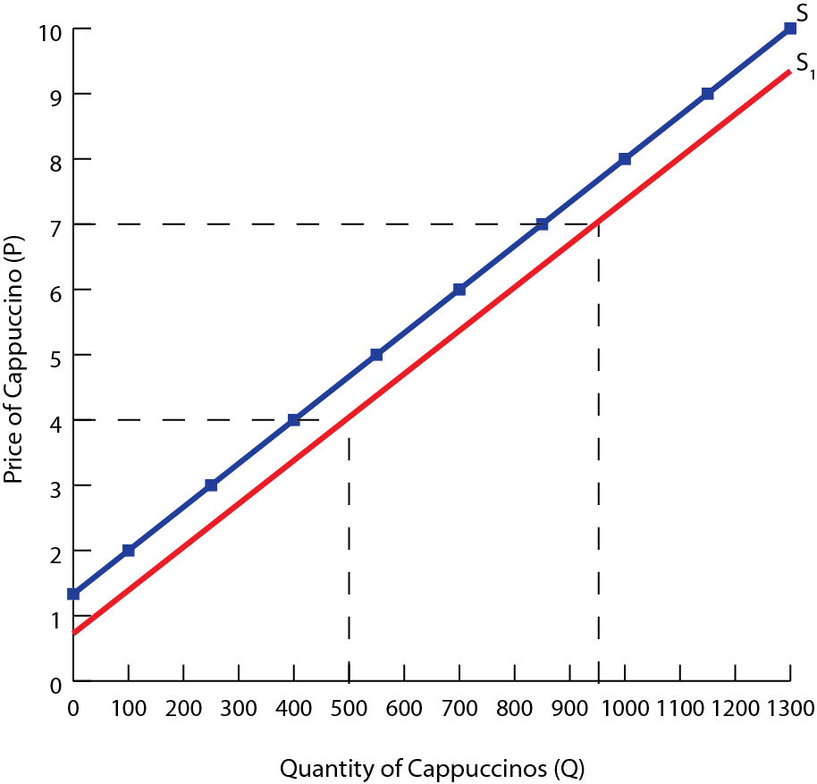
The quantity supplied at each price level is reduced, but the slope remains the same
The price intercept is now $0.75 rather than $1.33

Slide 15
Changes in ‘d’
Changes to the price coefficient d will change the steepness of the supply curve
This changes the price elasticity of the supply curve
Example; Suppose the supply function changes to Q = -200 + 200P
Linear supply schedule: Cappuccinos
Price of Cappuccinos (P) | Quantity supplied per day (Q_{D})
10 | 1800
8 | 1400
6 | 1000
4 | 600
2 | 200
0 | -200

Slide 16
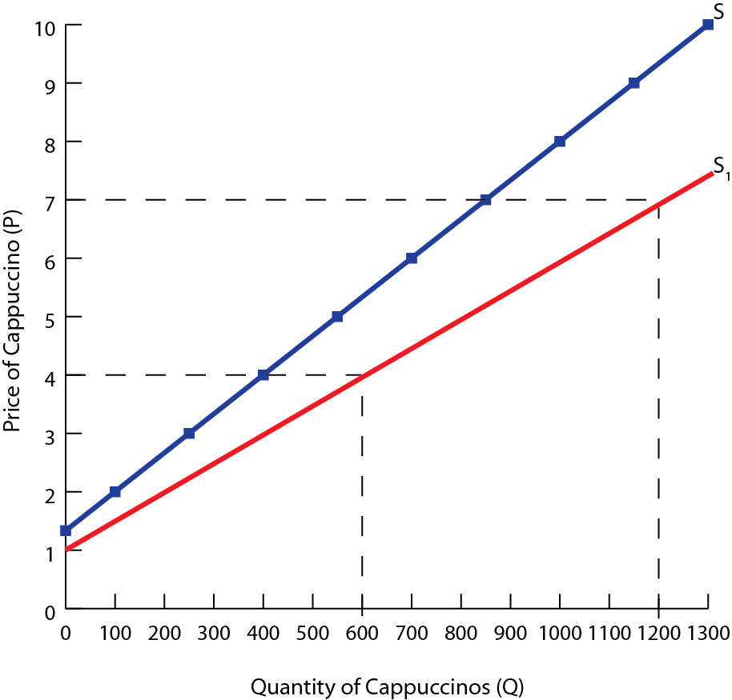
The supply curve is less steep, indicating consumers are more sensitive to price changes than previously
The overall supply for cappuccinos has become more elastic

Slide 17
Summary
 | Component | Change | Impact on Demand/Supply
Linear Demand (Q_{d} = a − bP) Linear Supply (Q_{s} = c + dP) | a or c | Increase | Rightward shift (Increase)
 | a or c | Decrease | Leftward shift (Decrease)
 | b or d | Increase | Less steep (Elastic)
 | b or d | Decrease | More steep (Inelastic)

Slide 18
Study Questions
1. Use the linear demand function, Q_{D} = 300 – 30P
A. Create a demand schedule with prices of $0, $3, $5, $7 and $9
B. Create a demand curve, plotting point from your demand schedule
C. Decrease the value of a, the autonomous element of demand, by 30 units. Create a new demand schedule, with the adjusted values for Q_{D}.
D. On your previous diagram, show the new demand curve
E. Now change the value of the price coefficient, in the original function to – 10. Calculate the prices and quantities demanded, and list them of a demand schedule
F. Create a new demand curve

Slide 19
Study Questions
1. Use the linear demand function, Q_{S} = -100 + 10P
A. Create a supply schedule with prices of $10, $20, $30, $40 and $50
B. Create a supply curve, plotting point from your demand schedule
C. Decrease the value of c, the autonomous element of supply, by 50 units. Create a new supply schedule, with the adjusted values for Q_{S}.
D. On your previous diagram, show the new supply curve

