Slide 1
Market Equilibrium and Linear Equations

Slide 2
Market Equilibrium and Linear Equations
Linear equations can be used to solve the market equilibrium by setting the quantity supplied equal to the quantity demanded
The market is in equilibrium when Q_{d} = Q_{s}
Example; Suppose the market for cappuccino can be modeled by the following, Q_{d} = 600 – 50P and Q_{s} = – 200+ 150P
Linear supply and demand schedules: Cappuccinos
Price of Cappuccinos (P) | Quantity demanded (Q_{D}) | Quantity supplied (Q_{S})
10 | 100 | 1300
8 | 200 | 1000
6 | 300 | 700
4 | 400 | 400
2 | 500 | 100
0 | 600 | -200

Slide 3
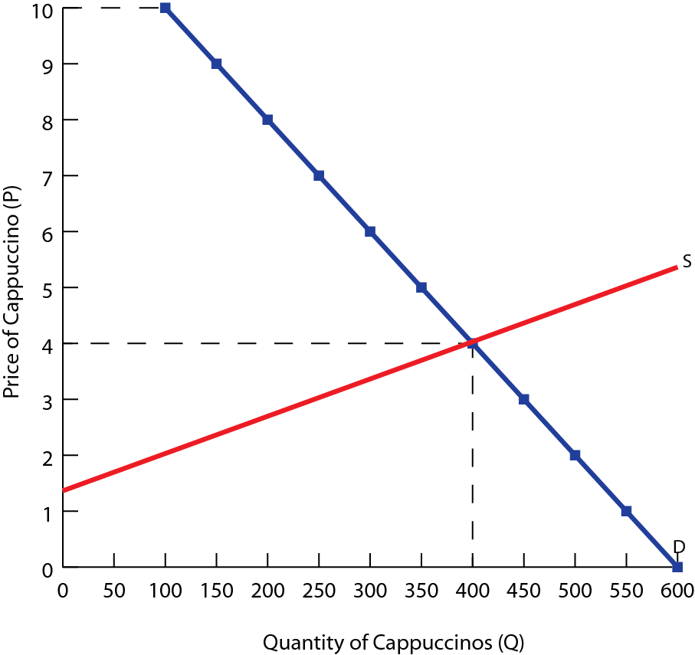
The equilibrium is the point at which supply equals demand,
Q_{d} = Q_{s}
600 – 50P = – 200+ 150P
200P =800
Therefore, P_{E}= $4 and Q_{E}= 400 units
Therefore the equilibrium price is $4 and the quantity is 400 units

Slide 4
Shifts in Supply and Equilibrium
Shifts in the supply can also be illustrated using linear functions
Example; Suppose the price of coffee beans increases, adding to the costs of the production of cappuccino and reducing the supply. The new supply function is Q_{s} = – 400+ 150P
Linear supply schedule: Cappuccinos
Price of Cappuccinos (P) | Quantity supplied per day (Q_{D})
10 | 1100
8 | 800
6 | 500
4 | 200
2 | -100
0 | -400

Slide 5
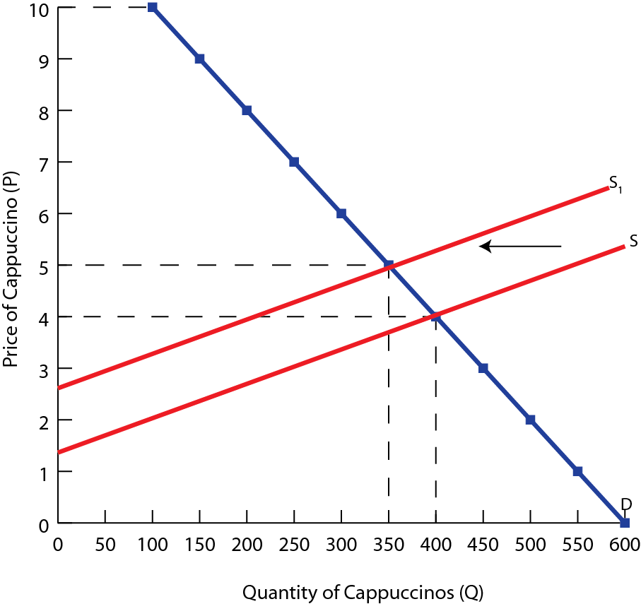
Solving the new equilibrium,
Q_{d} = Q_{s}
600 – 50P = – 400+ 150P
200P =1000
Therefore, P_{E}= $5 and Q_{E}= 350 units
The price rises until the market is cleared, with all excess demand eliminated

Slide 6
Shifts in Demand and Equilibrium
Changes in demand will also effect the equilibrium price and quantity
Example; Suppose a decrease in the demand for cappuccinos shifts the demand curve to the right. In addition, the demand curve becomes less elastic. The new demand function is Q_{d} = 400 – 25P
Solving the new equilibrium algebraically,
Q_{d} = Q_{s}
400 – 25P = – 200+ 150P
600P =175
Therefore, P_{E}= $3.43 and Q_{E}= 314 units

Slide 7
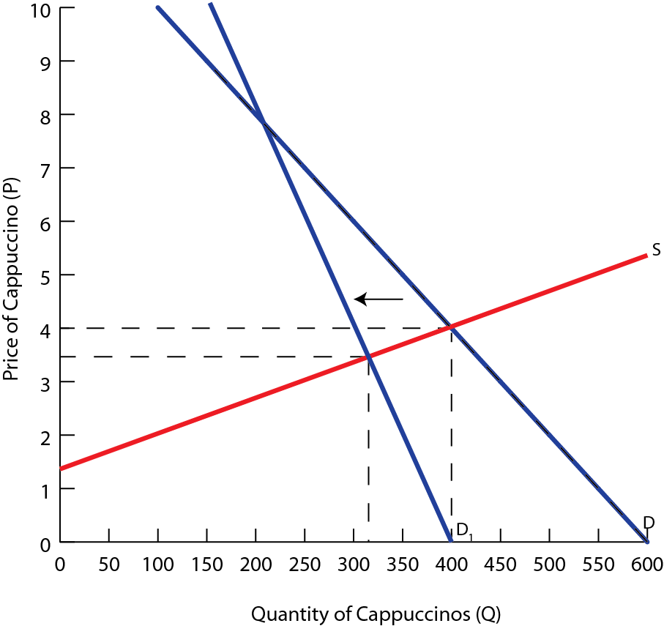
The decrease in demand causes the price of cappuccinos to fall from $4 to $3.43 and the equilibrium quantity to decrease from 400 to 314 drinks

