Slide 1
Tax & Subsidies and Linear Functions

Slide 2
Overview
Given a supply function of the general form Q_{S} = c + dP
Whenever there is a downward shift of the function by s units, where s is the subsidy per unit we replace P by P + s. The new supply function therefore becomes Q_{S} = c + d(P + s).
Whenever there is a upward shift of the function by t units, where t is the tax per unit we replace P by P − t. The new supply function therefore becomes Q_{S} = c + d(P − t).
 | Original Function | Revised Function
Taxes (t) | Q_{s} = c + dP | Q_{s} = c + d(P − t)
Subsidy (s) | Q_{s} = c + dP | Q_{s} = c + d(P + s)

Slide 3
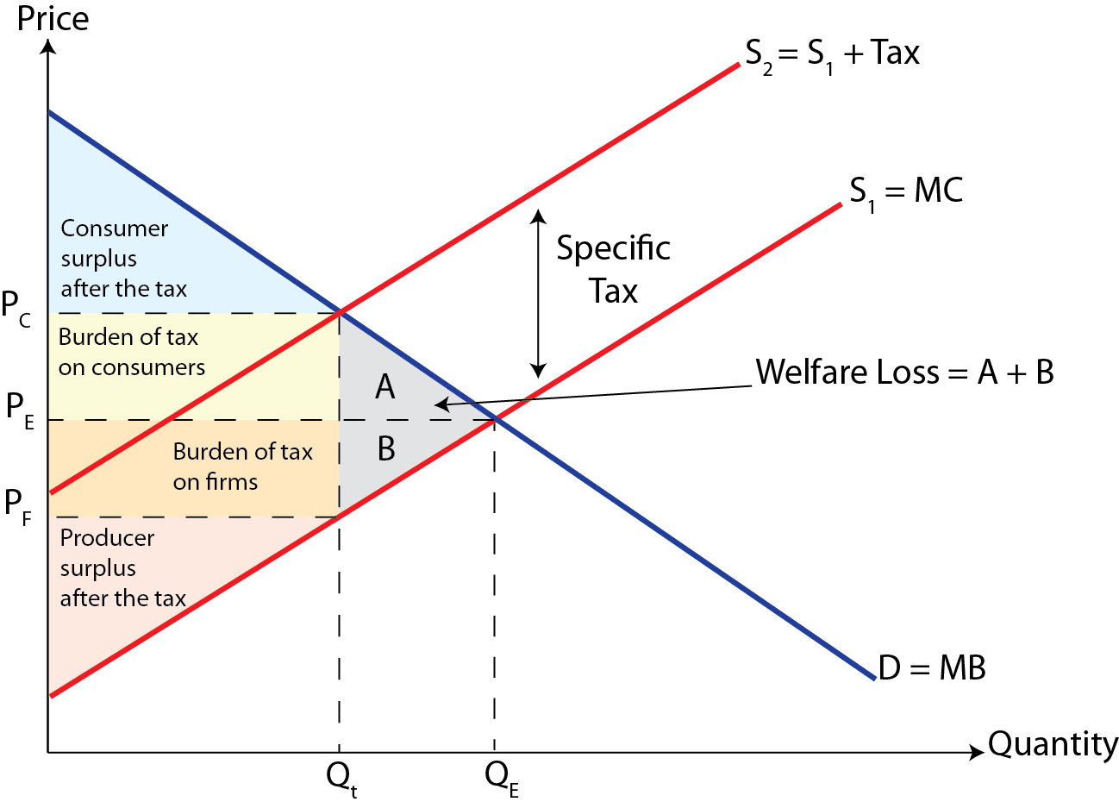
Recap- Indirect Taxes

Slide 4
Tax Incidence and Linear Functions
Linear functions can be used for the analysis of tax incidence
Example; Suppose the demand and supply of cigarettes can be modeled as follows, Q_{D} = 1600 – 200P and Q_{S} = 600 + 300P
Linear supply and demand schedules: Cigarettes
Price (P) | Quantity demanded (Q_{D}) | Quantity supplied (Q_{S})
5 | 600 | 2100
4 | 800 | 1800
3 | 1000 | 1500
2 | 1200 | 1200
1 | 1400 | 900
0 | 1600 | 600

Slide 5
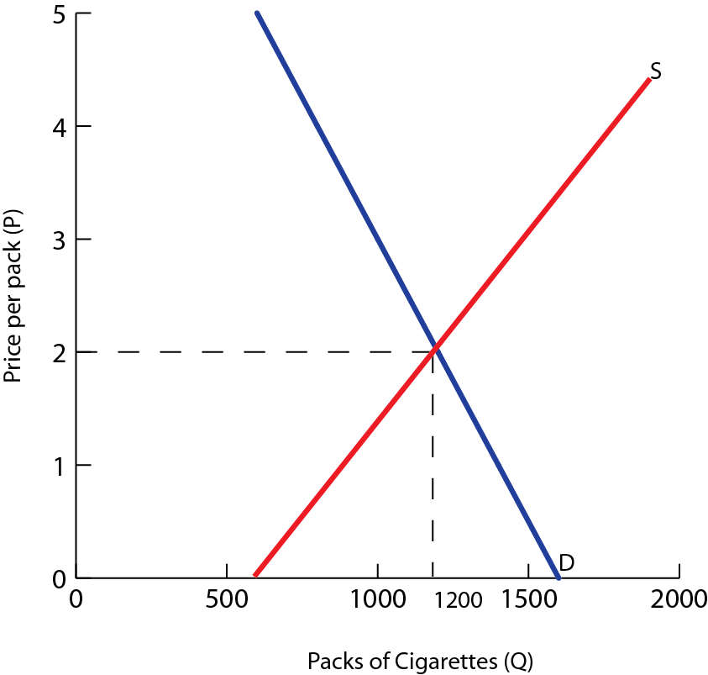
We can determine the equilibrium price and quantity, algebraically
Q_{d} = Q_{s}
1600 – 200P = 600+ 300P
500P =1000
Therefore, P_{E}= $2 and Q_{E}= 1200 units
Therefore the equilibrium price is $2 and the quantity is 1200 units

Slide 6
Example; Tax on Cigarettes
Example; Suppose the government places a $1 tax on each pack of cigarettes
The tax is a cost imposed on the producers of cigarettes, so whatever the price consumers pay, $1 must be given over to the government
Therefore, producers will receive $1 less than the new equilibrium price
The new supply function can be expressed as ,Q_{S} = 600 + 300(P – 1) or by simplifying we get Q_{S} = 300 + 300P
To determine the new equilibrium, we set the new supply equal to demand

Slide 7
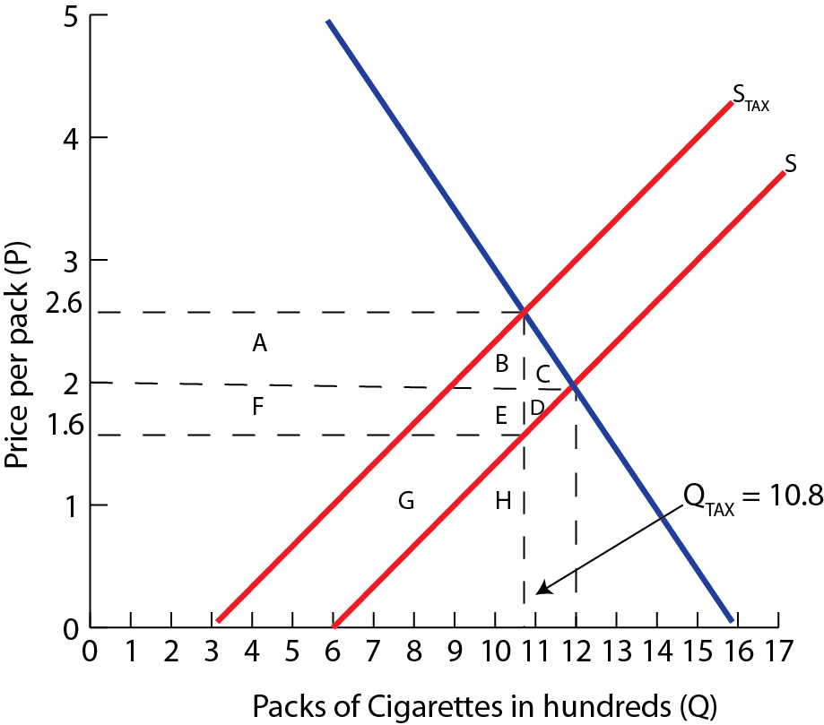
Q_{d} = Q_{s}
300 + 300P = 1600 - 200P
500P =1300
Therefore, P_{E}= $2.6 and Q_{E}= 1080 unit
Therefore the equilibrium price is $2.6 and the quantity is 1080 units
1080 = 600 + 300P
480 = 300P
P = $1.60
Calculate
1) Tax Revenue
2) Consumer Tax Burden
3) Producer Tax Burden
4) ∆ Consumer Surplus
5) ∆ Producer Surplus
6) Welfare Loss

Slide 8
Because the demand for cigarettes is relatively inelastic, the larger burden of the tax is passed on to consumers.
We can also analyze the impact of the tax on various other factors,
Tax revenue: is shown by the area A + B + E + F and is equal to $1 × 1080 = $1080
Consumer tax burden: is represented by the area A + B and is equal to ($2.60 - $2) × 1080 = $648
Producer tax burden: is represent by the area F + E and is equal to ($2 - $1.60) × 1080 = $432
Effect on consumer surplus: the loss of the consumer surplus is A + B + C which is equal to $648 + 0.5(72) = $684

Slide 9
Effect on producer surplus: the loss of producer surplus is represented by D + E + F and is equal to the producer burden plus the area of D which is $432 + 0.5(48) = $456
Welfare loss from the tax: overall, the amount of both consumer and producer surplus in the cigarette market falls because of the tax
The total loss in consumer and producer surplus is $1140
Net welfare loss = ∆G + ∆CS + ∆PS
= $1080 − $684 − $456
= $60
The tax on cigarettes creates $1080 of government revenue, but imposes a $60 welfare loss to society
Since consumers and producers of cigarettes lose more welfare than society gains in tax revenue

Slide 10
Subsidies and Linear Functions

Slide 11
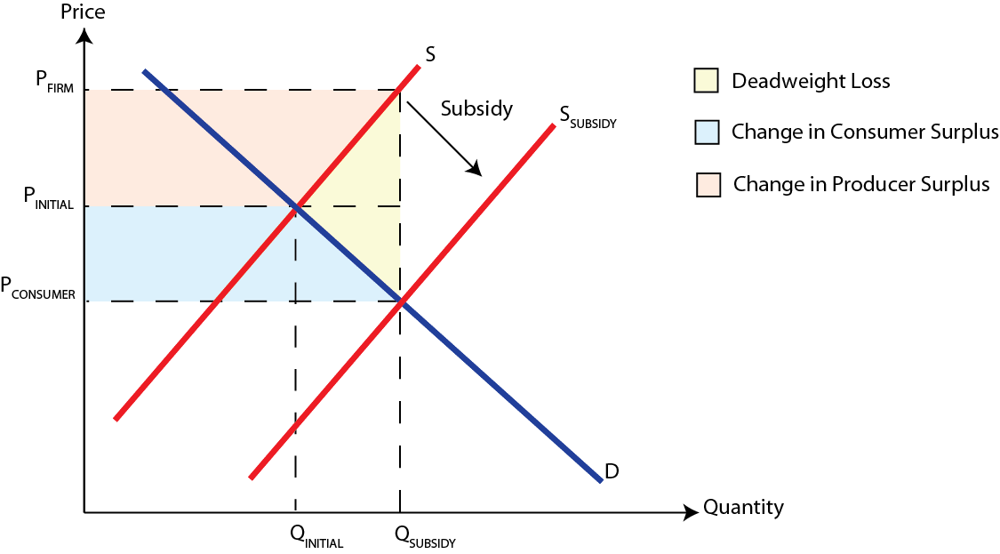
Recap- Subsidies

Slide 12
Subsidies and Linear Functions
Linear functions can be used for the analysis of subsidies
Example; Suppose the demand and supply of cotton can be modeled as follows, Q_{D} = 30 – 4P and Q_{S} = 6 + 2P
Linear supply and demand schedules: Cigarettes
Price (P) | Quantity demanded (Q_{D}) | Quantity supplied (Q_{S})
6 | 6 | 18
4 | 14 | 14
3 | 18 | 12
2 | 22 | 10
1 | 26 | 8
0 | 30 | 6

Slide 13
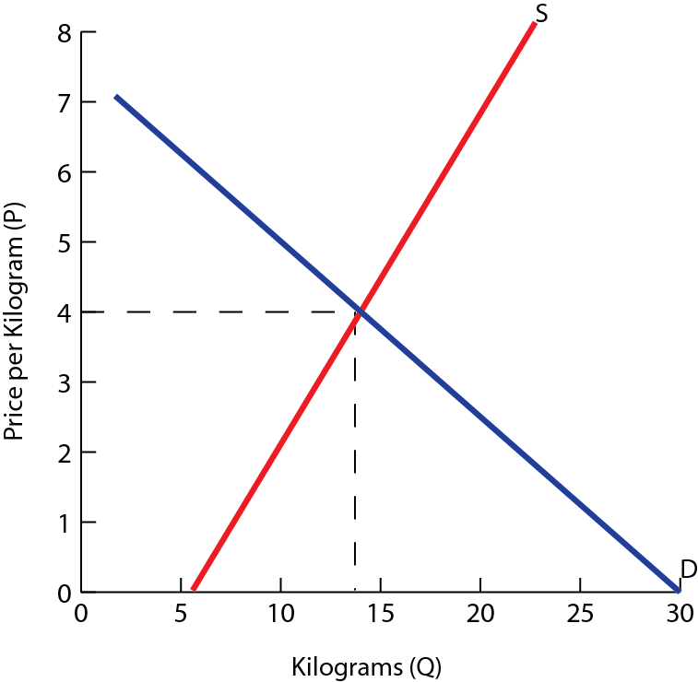
We can determine the equilibrium price and quantity, algebraically
Q_{d} = Q_{s}
30 – 4P = 6+ 2P
6P =24
Therefore, P_{E}= $4 and Q_{E}= 14 units
Therefore the equilibrium price is $4 and the quantity is 14 units

Slide 14
Example; Subsidy on Cotton
Example; Suppose the government places a $3 subsidy on each kilogram of cotton
The producers will now receive $3 more per kilogram produced than the price the consumers pay
The new supply function can be expressed as ,Q_{S} = 6 + 2(P + 3) or by simplifying we get Q_{S} = 12 + 2P
To determine the equilibrium after the price subsidy, we set the new supply function equal to demand

Slide 15
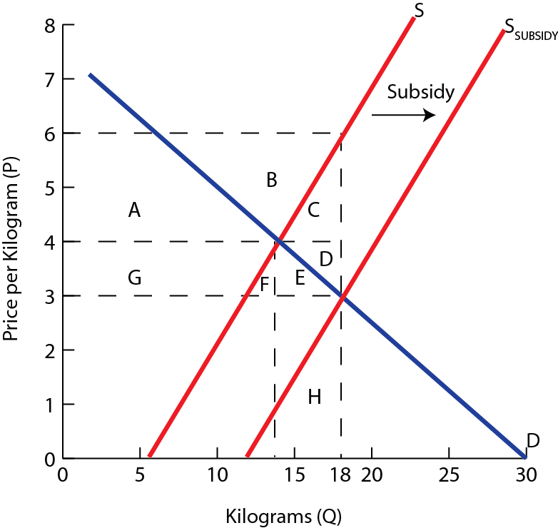
Q_{d} = Q_{s}
12 + 2P = 30 - 4P
6P =18
Therefore, P_{E}= $3 and Q_{E}= 18 units
Therefore the equilibrium price is $3 and the quantity is 18 units
Calculate
1) Government Spending
2) ∆ Consumer Surplus
3) ∆ Producer Surplus
4) Welfare Loss

Slide 16
Both consumer and producer welfare increases as a result of a subsidy,
Change in consumer surplus: the increase in the consumer surplus is E + F + G since consumers now enjoy a lower price and greater quantity. This is equal to $16 million
Change in producer surplus: the increase in producer surplus is A + B which is equal to $32 million
Increase in total consumer and producer welfare: the subsidy increases producer and consumer welfare by $48 million
We also need to take into the account the cost to taxpayers and society of subsidizing cotton grower
Total cost of the subsidy: is A + B + C + D + E + F + G and is equal to $3 × 18 = $54 million

Slide 17
Net effect on welfare: the cost of the subsidy was $54 million, but the benefit was only $48 million, so the net loss of welfare for society was $6 million
Deadweight (welfare) loss: is represented by the area of triangle C + D which is equal to $6 million
The subsidy creates a deadweight loss for society as a whole
The taxpayer money used to subsidize cotton growers exceeds the increase in cotton growers and consumers welfare by $6 million

