Slide 1
Price Ceilings & Price Floors

Slide 2
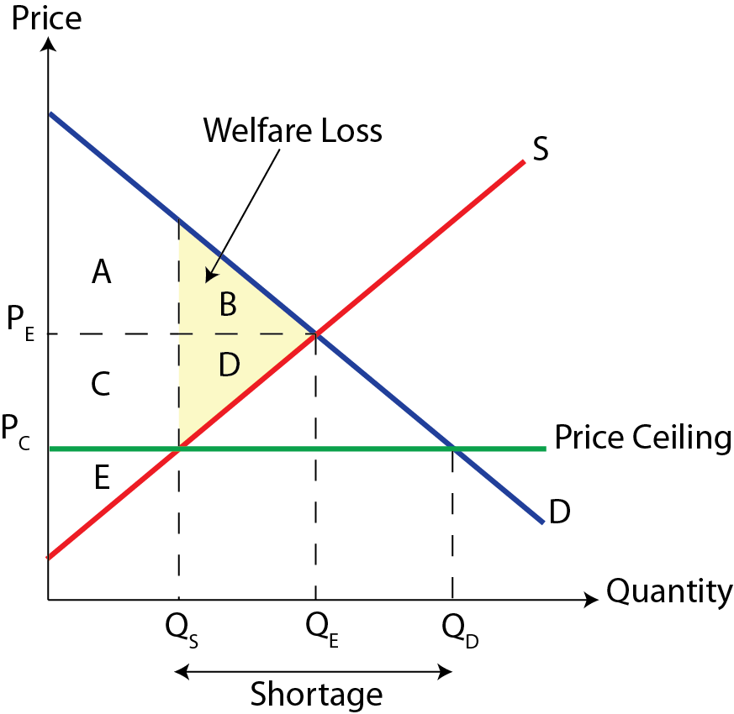
Recap- Price Ceiling
Price Ceiling- is a government imposed legal maximum price set below the market equilibrium.

Slide 3
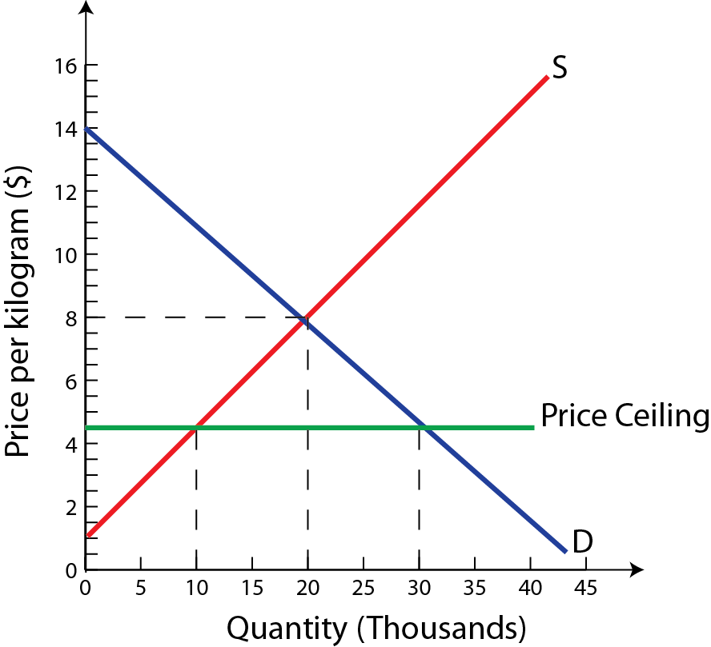
Price Ceiling
Example; Suppose the government imposes a price ceiling on rice of $4.50 per kilogram. This may be done to make basic food staples more affordable to low-income households.
Calculate
1) Shortage (Excess demand)
2) ∆ Consumer Spending
3) ∆ Producer Revenue

Slide 4
The original market equilibrium price was $8.00, at which 20,000 kilograms of rice are sold.
The price ceiling reduces the price to $4.50, which increases the quantity demanded to 30,000 and reduces the quantity supplied to 10,000 kilograms. Thus the price-ceiling results in a shortage.
Shortage: Q_{D} − Q_{S} = 30,000 − 10,000 = 20,000 kilograms
We can also analyze the impact of the price ceiling on the change in consumer expenditures or firm revenues.
∆Expenditures = Expenditures_{New} − Expenditures_{Old}
= ($4.50 × 10,000) − ($8.00 × 20,000)
= $45,000 − $160,000
= −$115,000

Slide 5
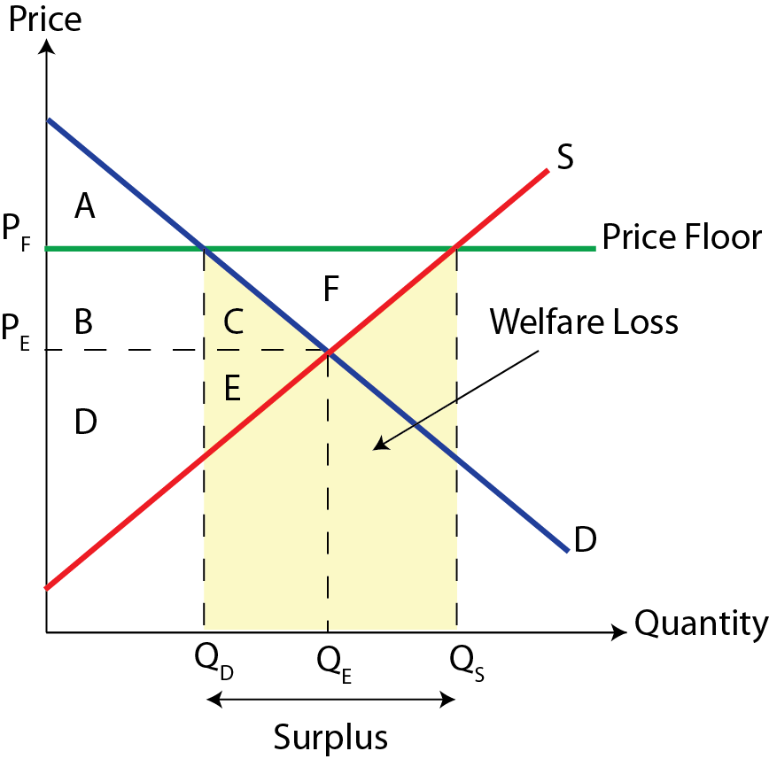
Recap- Price Floor
Price Floor- is a government imposed legal minimum price set above the market equilibrium.

Slide 6
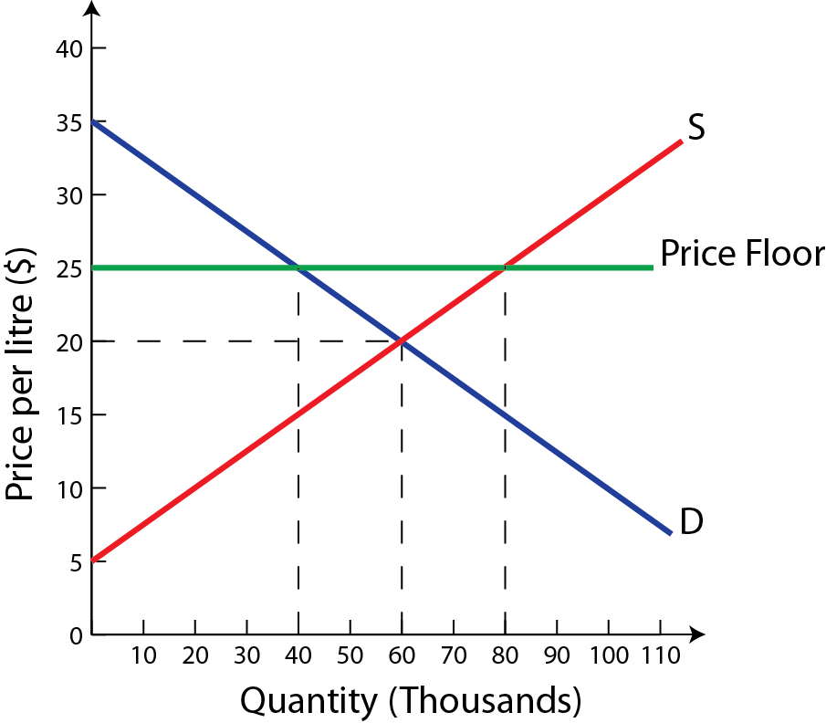
Price Floor
Example; Suppose the government imposes a price floor for wine of $25 per liter. This may be done to protect the income and employment of the country’s wine producers.
Calculate
1) Surplus (Excess supply)
2) ∆ Consumer Spending
3) ∆ Producer Revenue
4) Government Spending

Slide 7
The original market equilibrium price was $20, at which 60,000 liters of wine are sold.
The price ceiling raises the price to $25, which increases the quantity supplied to 80,000 and reduces the quantity demanded to 40,000 liters. Thus the price-floor results in a surplus.
Surplus: Q_{S} − Q_{D} = 80,000 − 40,000 = 40,000 liters
We can also analyze the impact of the price floor on various stakeholders,
∆Expenditures = Expenditures_{New} − Expenditures_{Old}
= ($25 × 40,000) − ($20 × 60,000)
= $1,000,000 − $1,200,000
= −$200,000
There is a reduction in consumer spending of $200,000

Slide 8
There is also an increase in the producers revenue of $800,000 as a result of the price floor.
∆Firm Revenue = Revenue_{New} − Revenue_{Old}
= ($25 × 80,000) − ($20 × 60,000)
= $2,000,000 − $1,200,000
= $800,000
The government must purchase the excess supply of wine to prevent the market from reverting back to the original equilibrium
Government Expenditure = Price × Quantity_{Surplus}
= ($25 × 40, 000)
= $1,000,000

