Slide 1
Revenue & Economic Profit

Slide 2
Revenues
    Total Revenue (TR): is obtained by multiplying the price at which the good is sold (P) by the number of units of the good sold (Q)
        TR = P × Q
    Marginal Revenue (MR): is the additional revenue arising from the sale of an additional unit of output
        MR = ∆TR ÷ ∆Q
    Average Revenue (AR): is the revenue per unit of output sold. It is always equal to the price.
        AR = TR ÷ Q
        = P

Slide 3
Revenues for Perfect Competition
    Perfectly competitive firms compete in a market with a large number of firms each producing an identical product, and each firm’s output making up a tiny fraction of the total market supply
        It is impossible for a single firm to affect the market price, and price at which the firm sells remains unchanged regardless of output
Output (Q) | Price (P) | Total Revenue TR = P × Q | Marginal Revenue MR = ∆TR ÷ ∆Q | Average Revenue AR = TR ÷ Q
1 | 10 | 10 | 10 | 10
2 | 10 | 20 | 10 | 10
3 | 10 | 30 | 10 | 10
4 | 10 | 40 | 10 | 10
5 | 10 | 50 | 10 | 10
6 | 10 | 60 | 10 | 10
7 | 10 | 70 | 10 | 10

Slide 4
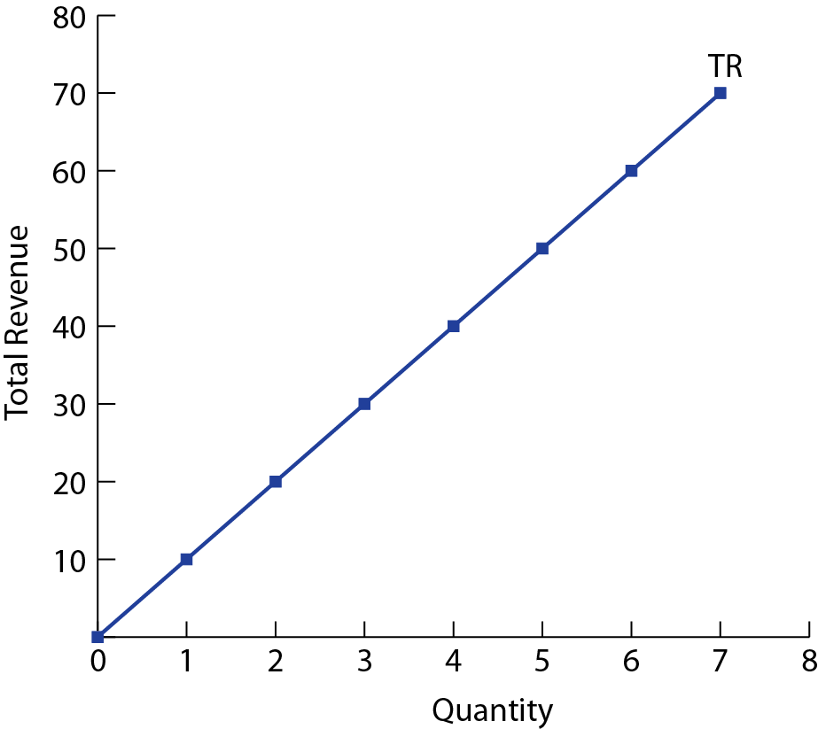
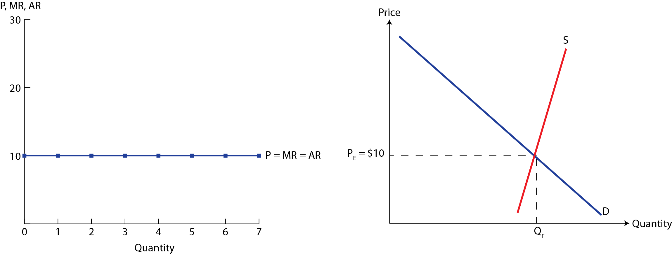
    For a perfectly competitive firm, P = D = MR = AR

Slide 5
Revenues for Imperfect Competition
    Imperfectly competitive firms have some degree of control over price, and the price varies with output. Such market structures include,
        Monopolistic competition, Oligopoly, and Monopoly
Output (Q) | Price (P) | Total Revenue TR = P × Q | Marginal Revenue MR = ∆TR ÷ ∆Q | Average Revenue AR = TR ÷ Q
1 | 12 | 12 | 12 | 12
2 | 11 | 22 | 10 | 11
3 | 10 | 30 | 8 | 10
4 | 9 | 36 | 6 | 9
5 | 8 | 40 | 4 | 8
6 | 7 | 42 | 2 | 7
7 | 6 | 42 | 0 | 6
8 | 5 | 40 | − 2 | 5
9 | 4 | 36 | − 4 | 4
10 | 3 | 30 | − 6 | 3

Slide 6
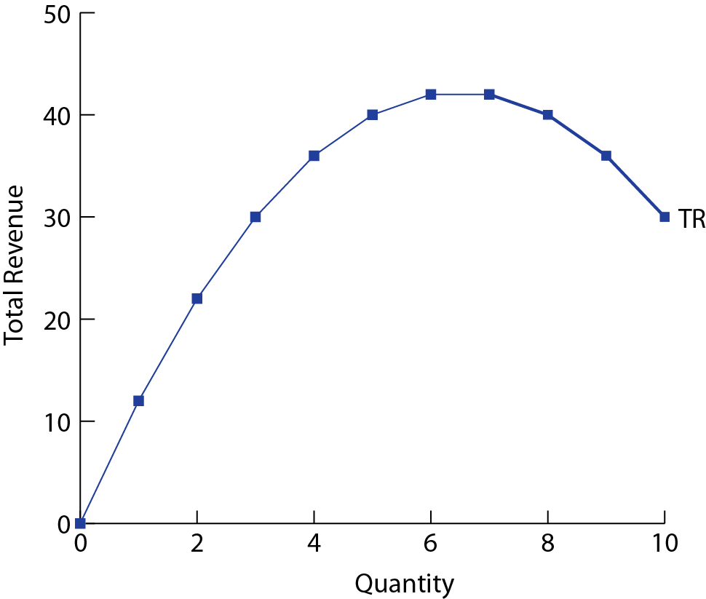
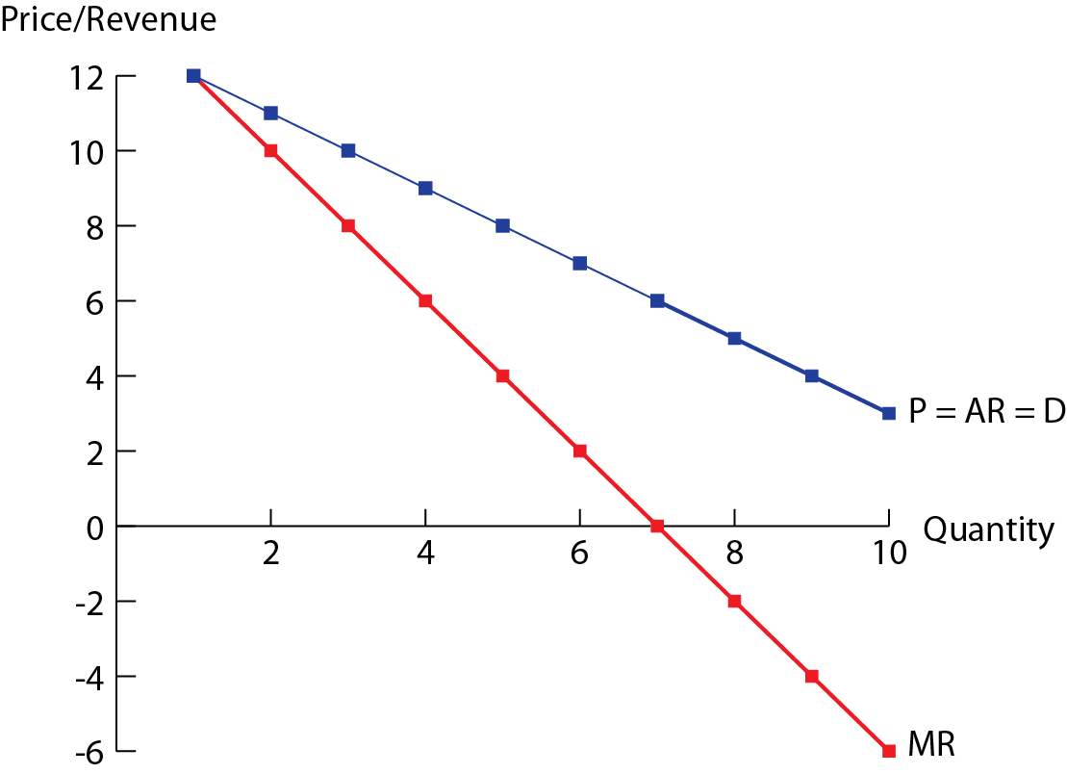

Slide 7
Profit & Revenue Maximization
    Recall, Profit = Total revenue − Total cost
      = TR − TC
    = Total revenue − Explicit costs − Implicit costs
    Economic profit can be positive, zero or negative
        Supernormal profit: TR > Economic cost (P > AC)
        Normal profit: TR = Economic cost (P = AC)
        Loss: TR < Economic cost (P < AC)
    Profit-maximization rule: a firm in any market structure should produce as close as possible to the point at which marginal revenue equals its marginal costs of production, where MR = MC
    Revenue-maximization rule: the revenue for a firm will be maximized at the output level in which MR = 0

Slide 8
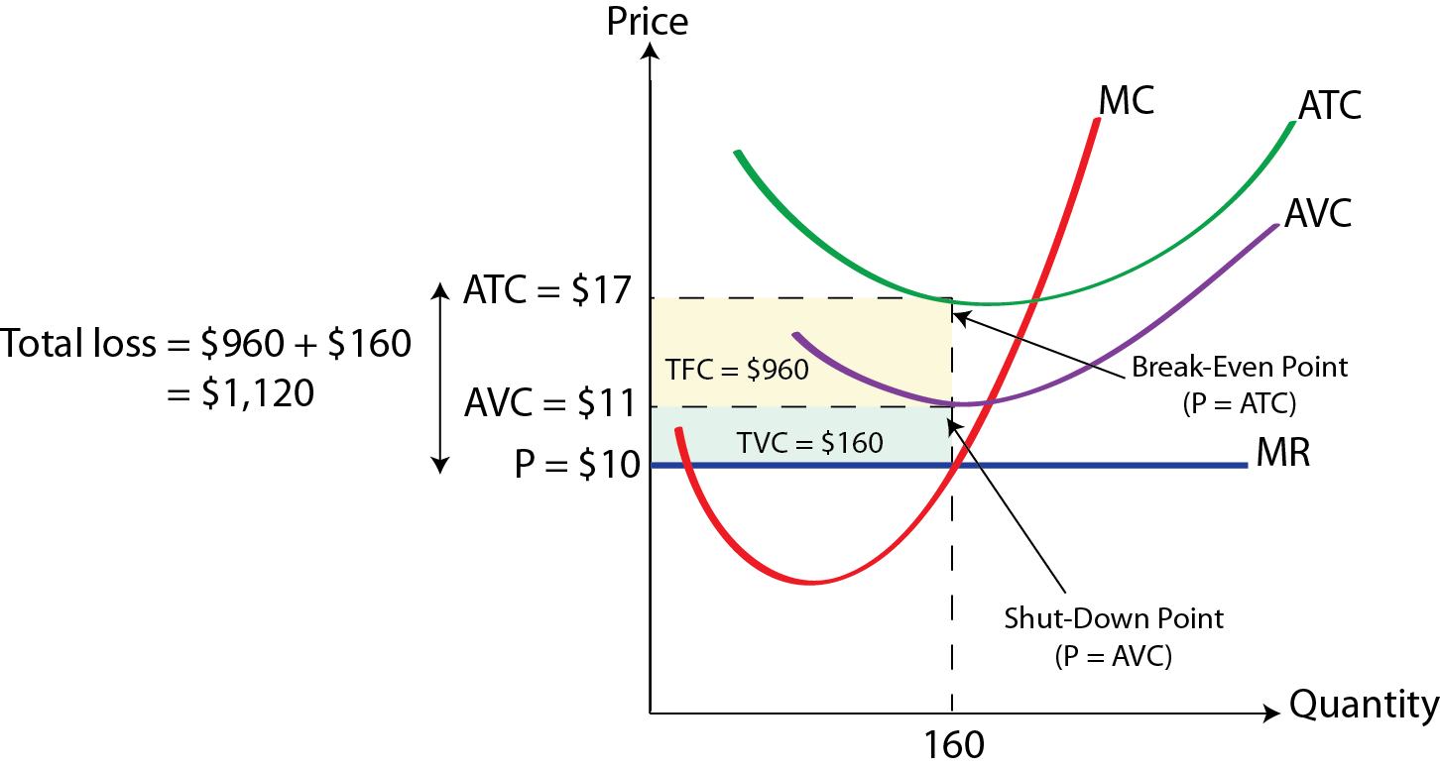
Shut-Down & Break-Even Price
    Break-even price: the firm’s break-even price occurs at the level of output for which the firm is earning a normal economic profit (P = AC)
    Shut-down price: a firm making an economic loss in the short-run will continue to produce a positive level of output as long as P ≥ AVC

Slide 9
Summary
Concept | Definition | Equation
Revenue Concepts
Total revenue (TR) | The total earnings of a firm from the sale of its output. | TR = P × Q
Marginal revenue (MR) | The additional revenue of a firm arising from the sale of an additional unit | MR = ∆TR ÷ ∆Q
Average revenue (AR) | Revenue per unit of output | AR = TR ÷ Q
Profit Concepts
Economic profit | Total revenue minus economic costs (or total opportunity costs which is the sum of explicit and implicit costs) | Profit = TR − TC
Normal profit | The minimum amount of revenue required by a firm so that it will be induced to keep running. | TR = TC or P = AC

