Slide 1
Measures of Economic Activity

Slide 2
Measures of Economic Activity
Recall, there are three ways to measure the value of aggregate output, suggested by the circular flow income model, all giving rise to the same results
1) Expenditure Approach: adds up all spending to buy final goods and services produced within a country over a period.
GDP = C + I + G + (X − M)
2) Income Approach: adds up all income earned by the factors of production that produce all goods and services within a country over a time period.
GDP = W + I + R + P
3) Output Approach: calculates the value of all final goods and services produced in a country over a time period.

Slide 3
Distinction between GDP & GNP
Gross domestic product (GDP): is the market value of all final goods and services produced in a country over a time period, usually a year.
GDP = C + I + G + (X − M)
Gross national product (GNP/GNI): is the value of all final goods and services produced by the factors of production supplied by a country’s residents regardless of where the factors are located.
GNP = GDP + Income from abroad − Income sent abroad
= GDP + Net income from abroad
Green GDP: is an adjustment of traditional GDP, deducting resource and environmental costs in economic activities.
Green GDP = GDP − Value of environmental degradation

Slide 4
Calculating GDP
Example; The table below shows the spending components for the United States national income in 2013.
GDP = C + I + G + (X − M)
= $11.5 + $2.67 + $3.13 + ($2.10 − $2.67)
= $16.73 trillion
Component | Value (in trillions)
Consumption (C) | $11.5
Investment (I) | $2.67
Government Spending (G) | $3.13
Exports (X) | $2.10
Imports (M) | $2.67

Slide 5
Calculating GNP
Example; Suppose in 2013, Canada’s GDP was $1,821 billion; Income earned abroad and sent home to Canada was $110 billion; Income earned in Canada and sent abroad was $29 billion. What was Canada’s 2013 GNP?
GNP = GDP + Net income from abroad
= $1,821 + ($110 − $29)
= $1,902 billion
Since GNP > GDP it indicates that Canada has significant foreign presence, in either workers or companies.

Slide 6
Real GDP & Nominal GDP
Nominal GDP: is measured in terms of current output valued at current prices, which does not account for changes in prices.
Real GDP: is a measure of economic activity that has eliminated the influence of changes in prices.
It measures the value of current output valued at constant prices so a relative comparison can be made to the base year
It is important to use real values when GDP is being compared over time

Slide 7
Example; Real GDP & Nominal GDP
Calculating Nominal GDP
 | 2001 |  |  | 2002 |  |  | 2003
Item | Quantity | Price | Value | Quantity | Price | Value | Quantity | Price | Value
Burgers | 37 | $3 | $111 | 40 | $4 | $160 | 39 | $5 | $195
Haircuts | 15 | $18 | $270 | 17 | $20 | $340 | 18 | $21 | $378
Tractors | 10 | $50 | $500 | 11 | $60 | $660 | 10 | $65 | $650
Nominal GDP |  |  | $881 |  |  | $1160 |  |  | $1223
Calculating Real GDP (Base year- 2001)
 | 2001 |  |  | 2002 |  |  | 2003
Item | Quantity | Price | Value | Quantity | Price | Value | Quantity | Price | Value
Burgers | 37 | $3 | $111 | 40 | $3 | $120 | 39 | $3 | $117
Haircuts | 15 | $18 | $270 | 17 | $18 | $306 | 18 | $18 | $324
Tractors | 10 | $50 | $500 | 11 | $50 | $550 | 10 | $50 | $500
Real GDP |  |  | $881 |  |  | $976 |  |  | $941

Slide 8
GDP Deflator
The GDP deflator is a price index that is an indicator of price changes for all good and services produced in the economy
GDP Deflator = (Nominal GDP ÷ Real GDP) × 100
The index number for the base year is always 100, for all indices
An increasing GDP deflator indicates rising prices on average, while a decreasing GDP deflator indicates falling prices.
Year | Nominal GDP | Real GDP | GDP Deflator
2001 | $881 | $881 | 100
2002 | $1160 | $976 | 118.8
2003 | $1223 | $941 | 130

Slide 9
GDP Deflator & Real GDP
The GDP deflator is a price index that is commonly used to covert nominal GDP to real GDP.
Real GDP = (Nominal GDP ÷ GDP Deflator) × 100
= (Nominal GDP ÷ CPI) × 100
Example; Suppose the nominal GDP was $7,850 billion in 2001; $9,237 billion in 2002; and $10,732 billion in 2003. The GDP deflator was 100 in 2001; 118.8 in 2002; and 130 in 2003.
Real GDP₂₀₀₁ = ($7,850 ÷ 100) × 100
= $7,850 billion
Real GDP₂₀₀₂ = ($9,237÷ 118.8) × 100
= $7,775 billion
Real GDP₂₀₀₃ = ($10,732 ÷ 130) × 100
= $8,255 billion

Slide 10
Calculating Economic Growth
Recall, economic growth refers to an increase in real GDP over time.
It is usually expressed as a percentage change in real GDP over a specified period of time.
%∆GDP= (GDP_{NEW} − GDP_{OLD}) ÷ GDP_{OLD}
It is important to distinguish between a decrease in GDP and a decrease in GDP growth
A decrease in GDP involves a fall in the value of output produced, which gives rise to a negative growth rate
A decrease in GDP growth, involves falling rates of growth, but the rates may be positive

Slide 11
Example; Economic Growth
Example; Given the values for real GDP we can calculate the growth rates between successive years.
Year | Real GDP ($ Billion) | Growth Rate | Description
2010 | 210 | − | −
2011 | 215.5 | 2.6% | Increasing GDP
2012 | 219.5 | 1.9% | Falling GDP growth
2013 | 223.1 | 1.6% | Falling GDP growth
2014 | 217.0 | −2.7% | Negative GDP growth

Slide 12
Keynesian Multiplier
Keynesian Multiplier (k): tells us the amount by which a particular injection of government spending, investment, or export spending will increase the nation’s total GDP
The spending multiplier is a function of the marginal propensity to consume and is determined from the formula,
k = Change in Real GDP ÷ Initial Change in Expenditure
= 1 ÷ (1 − MPC)
= 1 ÷ (MPS + MPT + MPM)
Recall, that MPC + MPS + MPT + MPM = 1 since if national income increases fractions of the funds will be consumed, saved, taxed and spent on imports

Slide 13
The larger the MPC and the smaller the leakages from the spending stream, the greater the value of the multiplier
The change in GDP (∆GDP) resulting from an initial change in expenditures (∆E) is,
∆GDP = k × ∆E
Example; Suppose the economy is in a recession and the government increases expenditures by $8 million. Assuming the MPC = 0.75 we can determine the value of the multiplier and change in real GDP.
Round | ∆GDP ($ million) | ∆Consumption ($ million)
1 | 8 | 0.75 × 8 = 6
2 | 6 | 0.75 × 6 = 4.5
3 | 4.5 | 0.75 × 4.5 = 3.38
4 | 3.38 | 0.75 × 3.38 = 2.5
Total | 32 | 0.75 × 32 = 24

Slide 14
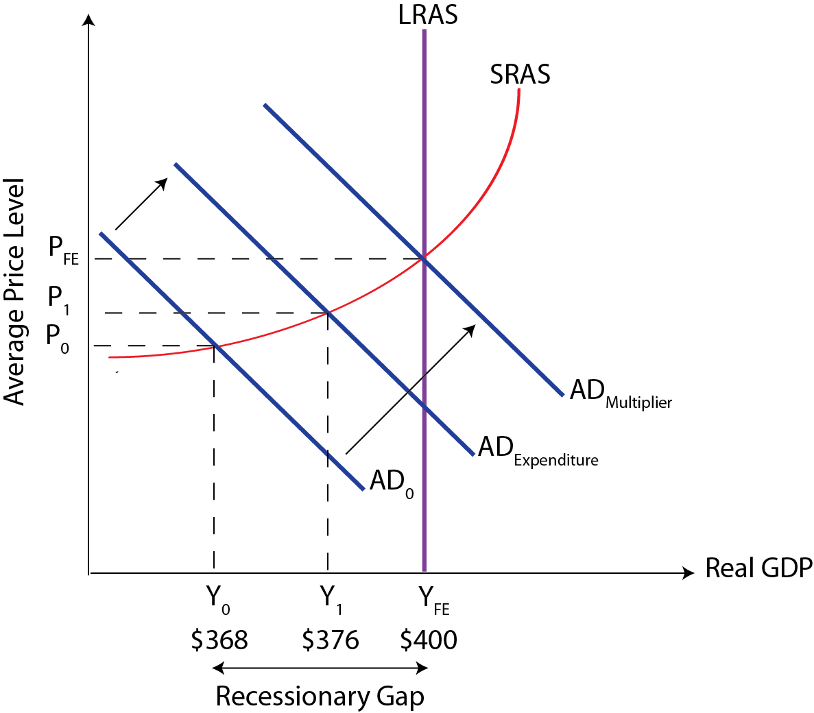
The Keynesian multiplier, k = 1 ÷ (1 − MPC)
= 1 ÷ (1 − 0.75)
= 4
Real GDP increases more than proportionally and the government expenditure of $8 million increases real GDP by $32 million.
∆GDP = k × ∆E
= 4 × $8
= $32 million

Slide 15
Study Questions
1. You are given the following information on an imaginary country called Lakeland.
A. Which year is the base year
B. Calculate real GDP for each of the five years in the table
2. Calculate nominal GDP, given the following information from the national accounts of Flatland (all figures are in billions). Consumer spending $125; Government spending $46; Exports of $12 and imports of $17.
Year | 2006 | 2007 | 2008 | 2009 | 2010
Nominal GDP | 19.9 | 20.7 | 21.9 | 22.6 | 22.3
GDP Deflator | 98.5 | 100 | 102.3 | 107.6 | 103.7

